Slide 1


Robotics Workshop
Session
4

Slide 2

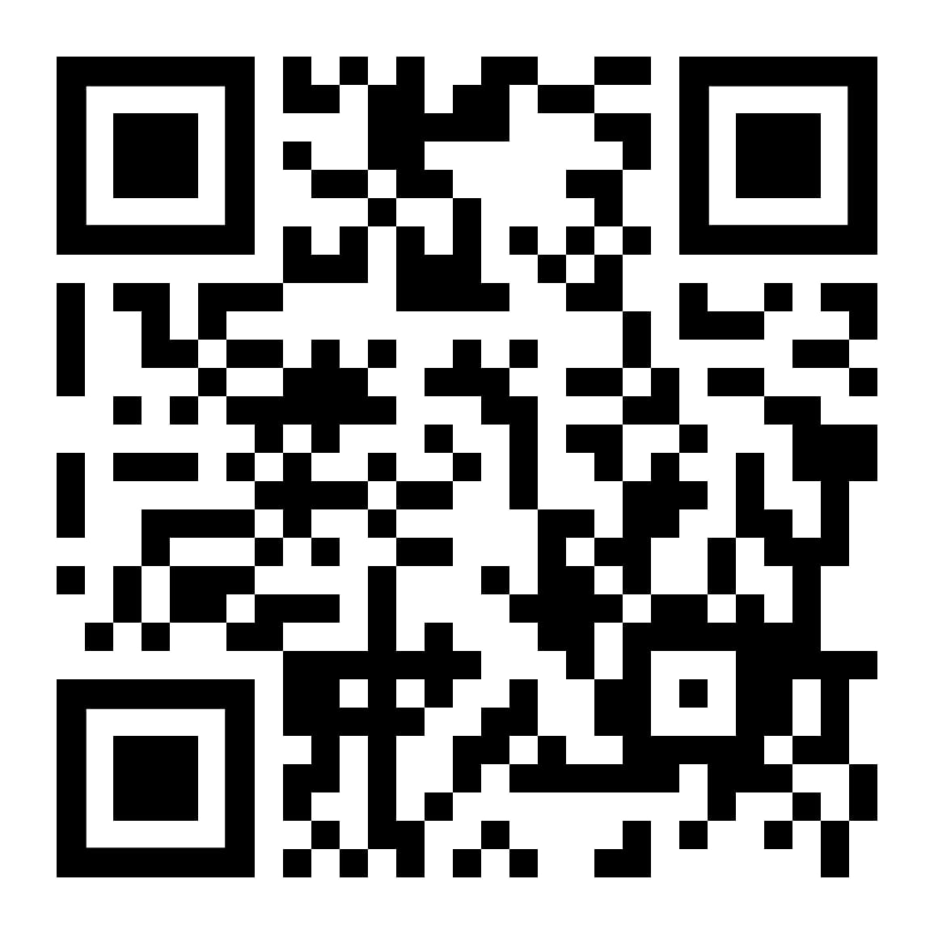



Slide 3
Hello!
Instructor: Yousef Khaled.
Cairo University, EECE Department.
Contact me: youefkh05@gmail.com
LinkedIn: https://shorturl.at/hgsIP

Slide 4
Content
Push button vs latch
Pull up and pull down resistor
Logical and Relational operators
If statement
Bouncing and Debouncing
Assignment 5

Slide 5

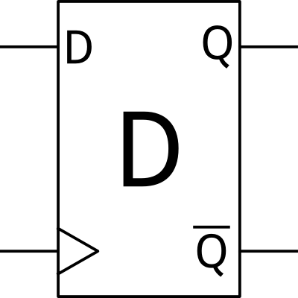

Push button vs latch

Slide 6

Push button vs latch
Difference
Push Button only sends a signal when pressed and returns to its original state when released.
Latch "remembers" its state after being triggered, staying in that state until an external action changes it.
Example
Push Button: A doorbell, where you press the button to ring the bell and release it to stop the action.
Latch: A light switch, where you toggle the switch to turn the light on or off, and it stays in that state.

Slide 7

Push button vs latch

Slide 8
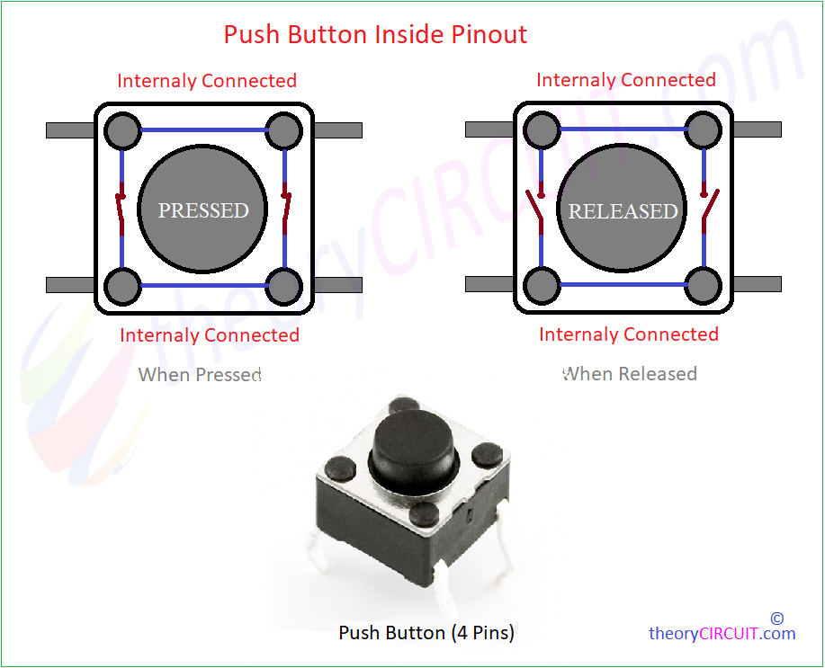
Push button Connection

Slide 9
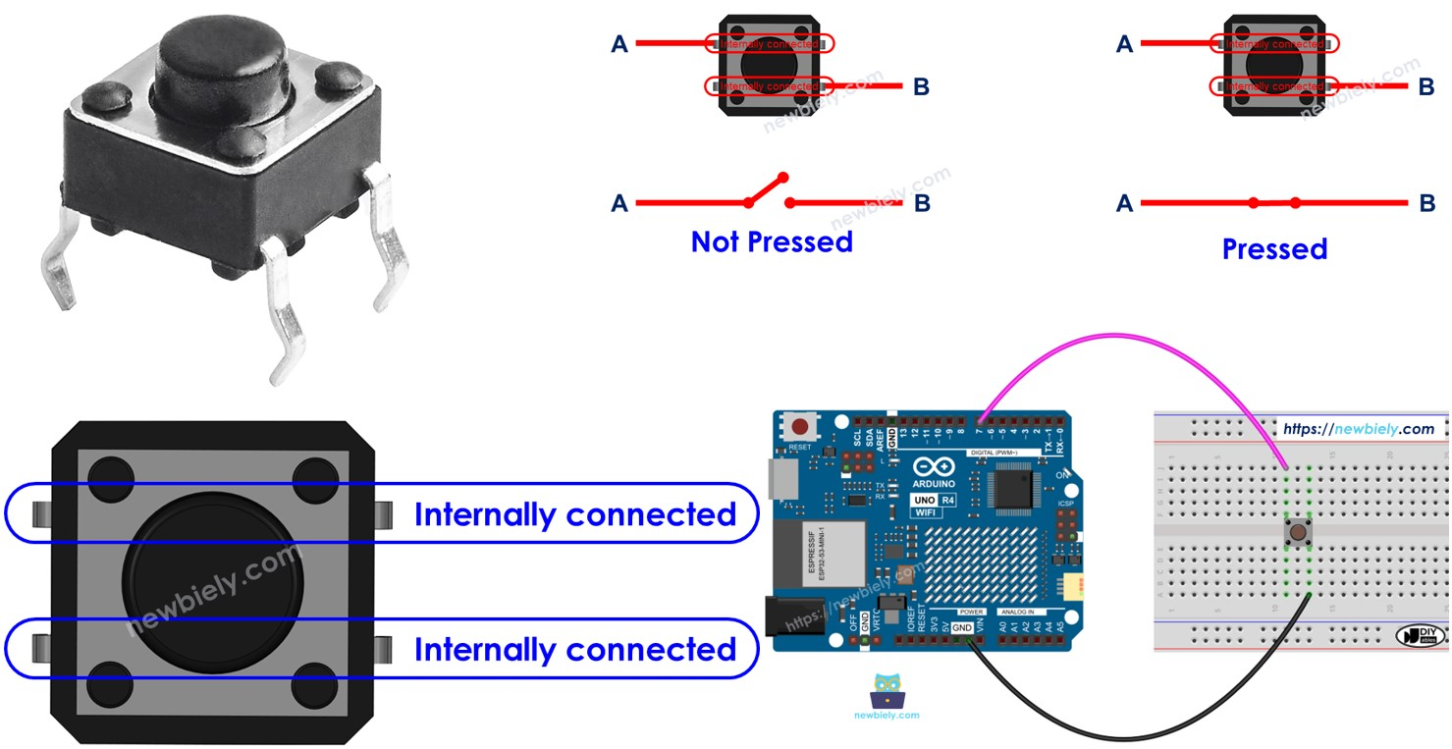
Push button Connection

Slide 10
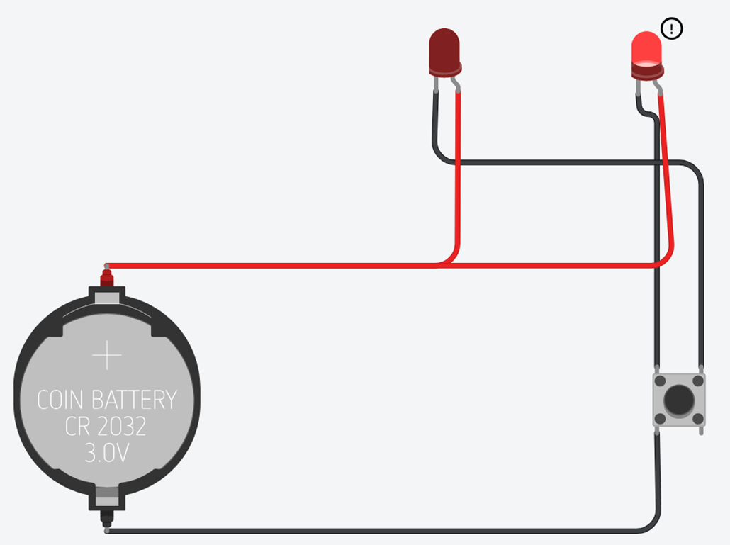
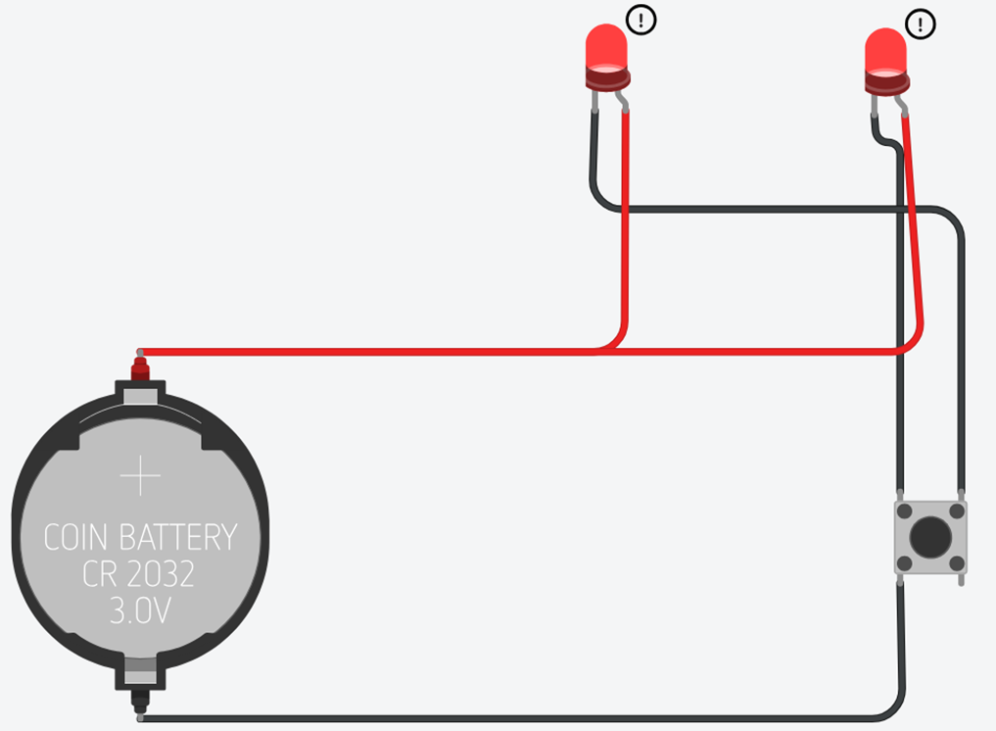
Push button Connection

Slide 11
Pull up and pull down resistor

Slide 12
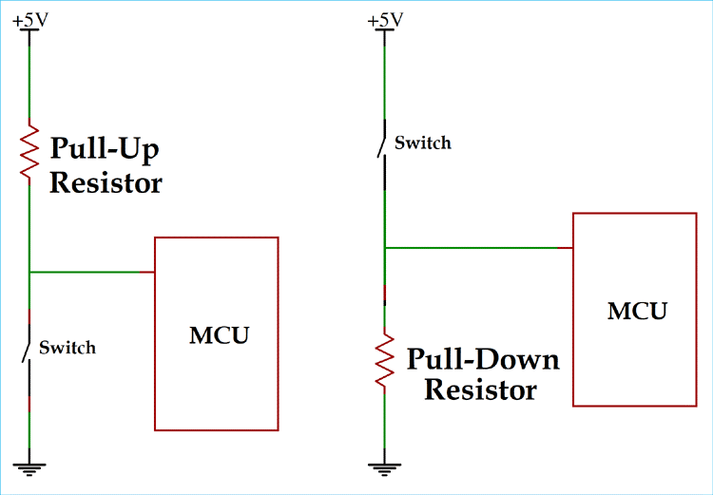
Pull up vs pull down
Floating
Pull Up
Pull Down

Slide 13
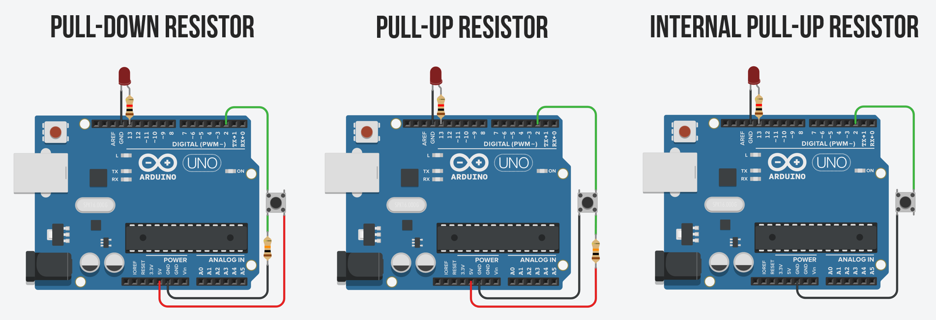
Pull up vs pull down

Slide 14
Task: Control led using push button
When pressing the push button, the led lights and when releasing our hand the led turns off ;

Slide 15
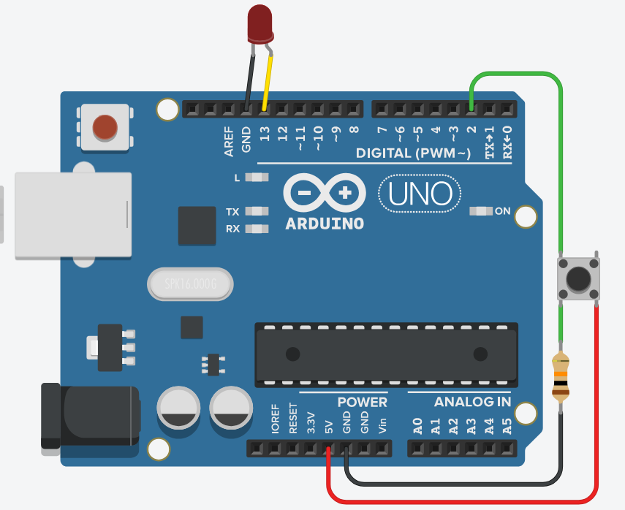
Task Solution

Slide 16
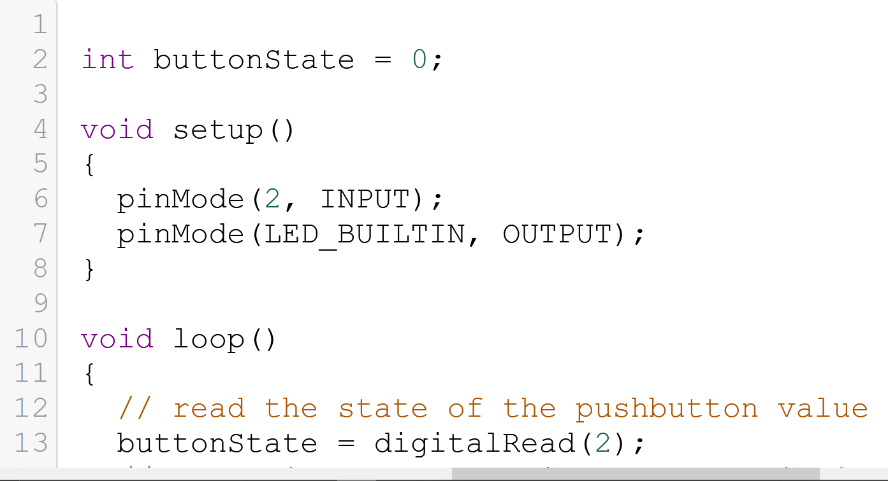
Task Solution

Slide 17
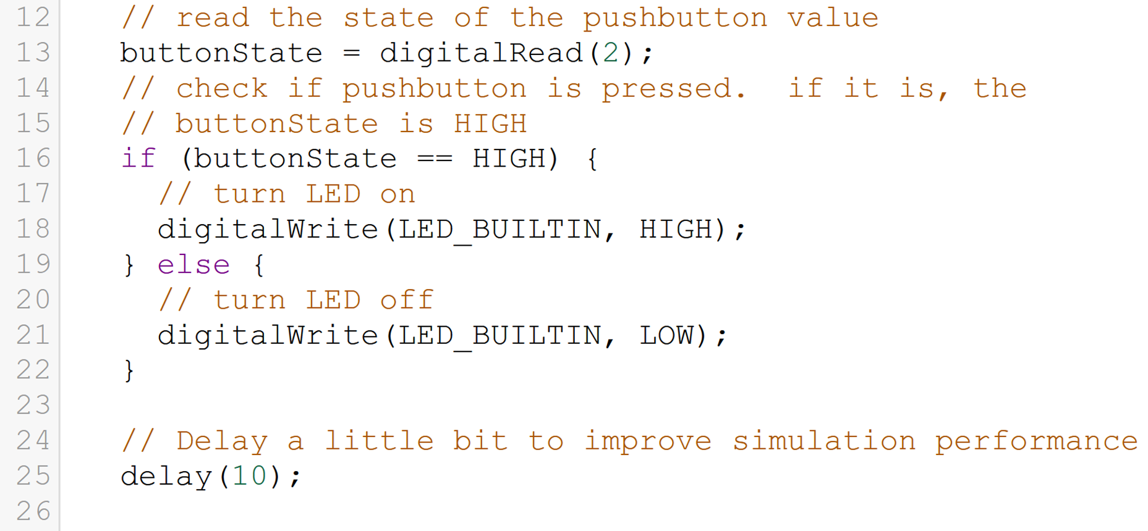
Task Solution

Slide 18
Logical and Relational operators

Slide 19
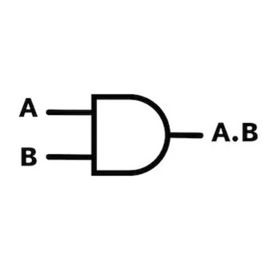
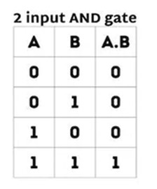
Logical operators
Example
And Gate & (.)
01100
&
11001
01000

Slide 20
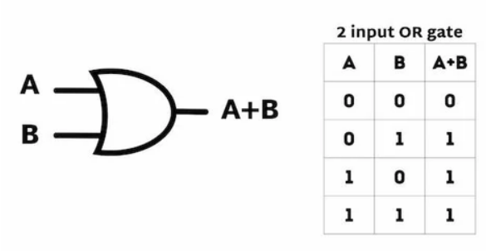
Logical operators
Example
Or Gate | (+)
01100
|
11001
11101

Slide 21
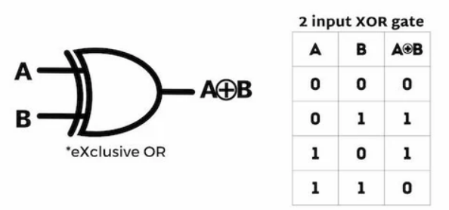
Logical operators
Example
XOr Gate ^ (⊕)
01100
^
11001
10100

Slide 22
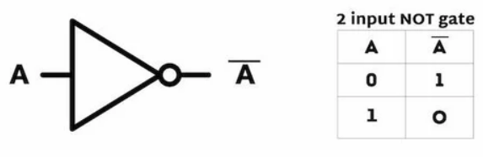
Logical operators
Example
Not Gate ! (~)
01100
~
10011

Slide 23
Relational operators
Operators
Example
==
!=
>
>=
<
<=
X=3
Y=4
Z= X<=Y
Z= X==Y
Z = X>Y

Slide 24
If statement

Slide 25
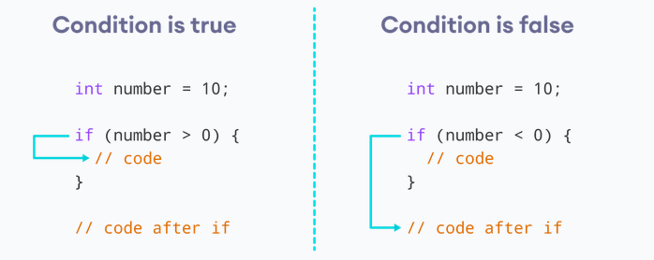
If statement
If

Slide 26
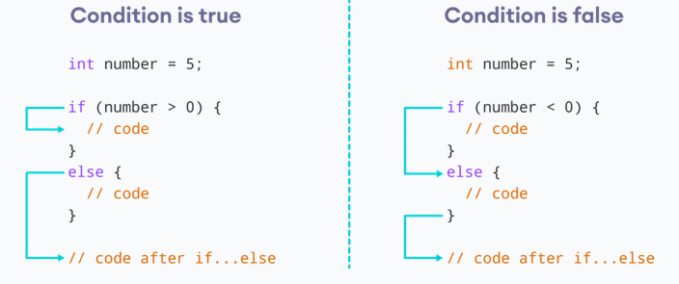
If else statement
If else

Slide 27
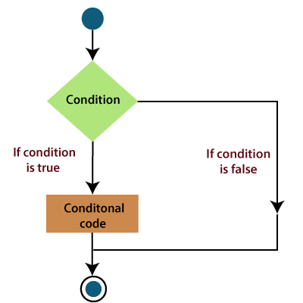
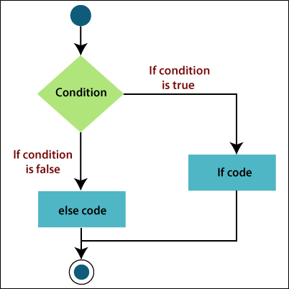
Difference between If and If else statement

Slide 28
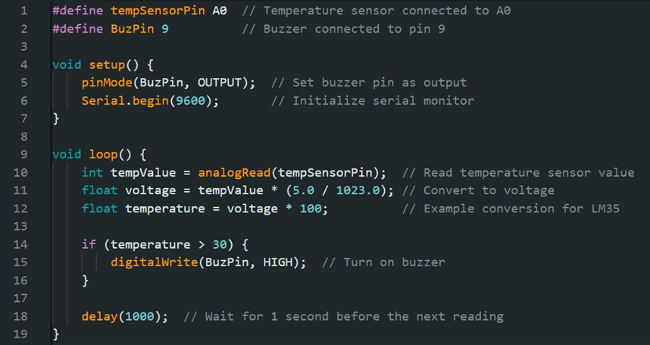
If statement
If
If (disturbance){
Turn On car Alarm;
}
// rest of the code
Turn On LED?

Slide 29
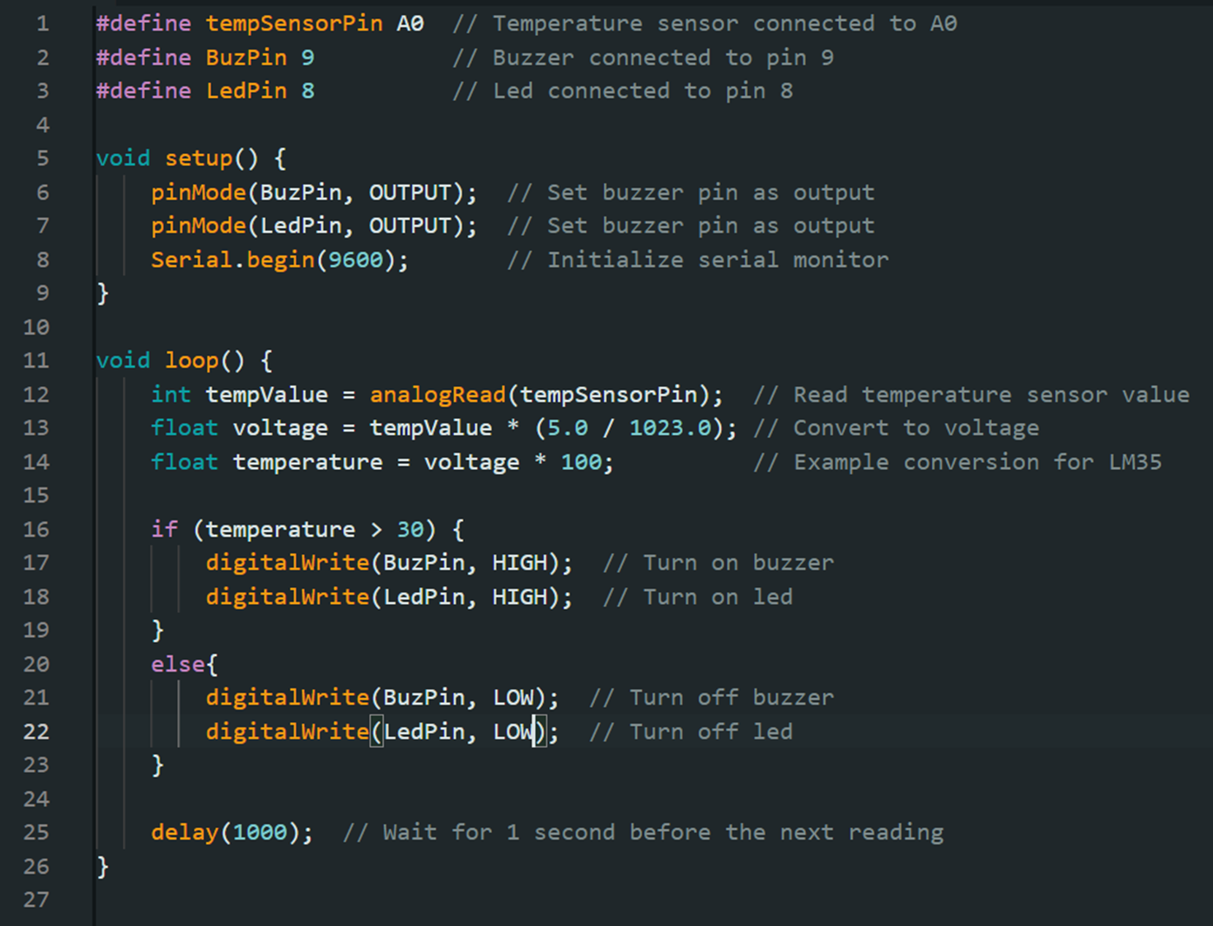
If else statement
If else
If (disturbance){
Turn On car Alarm;
Turn On LED;
}
Else{
Turn Off LED;
}
// rest of the code

Slide 30
Task : Toggle led
When push button is pressed, toggle led.

Slide 31
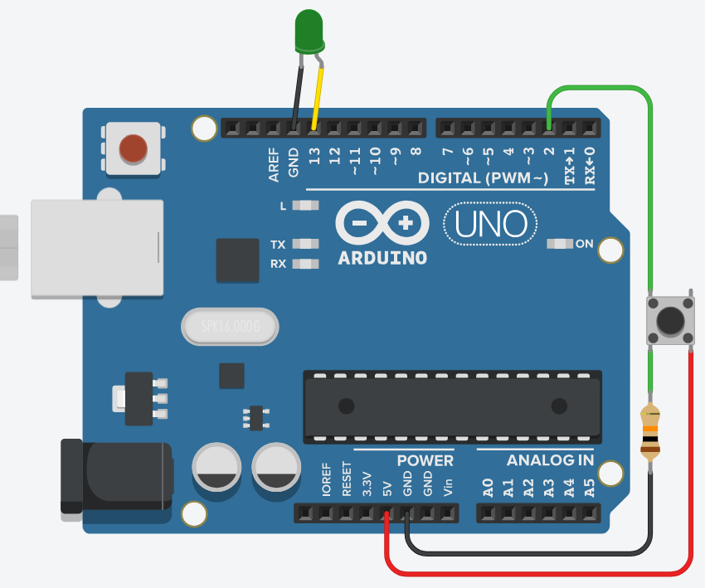
Task Solution

Slide 32
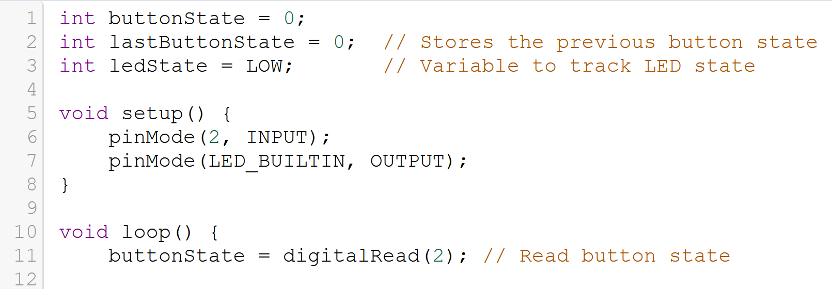
Task Solution

Slide 33
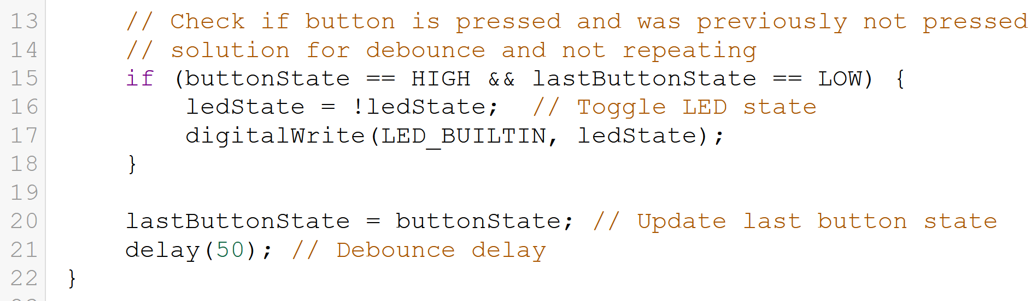
Task Solution

Slide 34
Bouncing and Debouncing

Slide 35
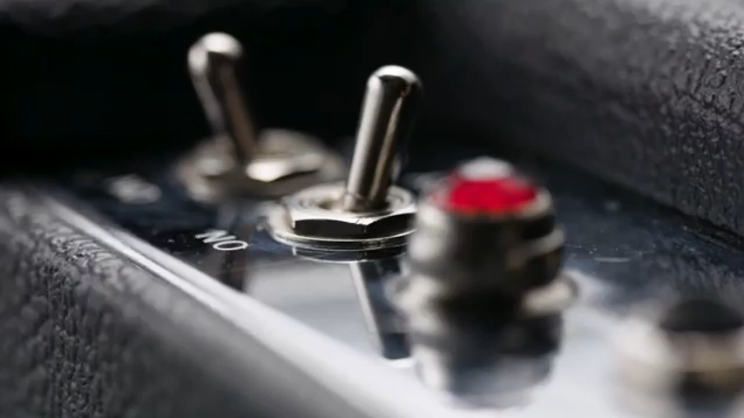
Bouncing and Debouncing

Slide 36
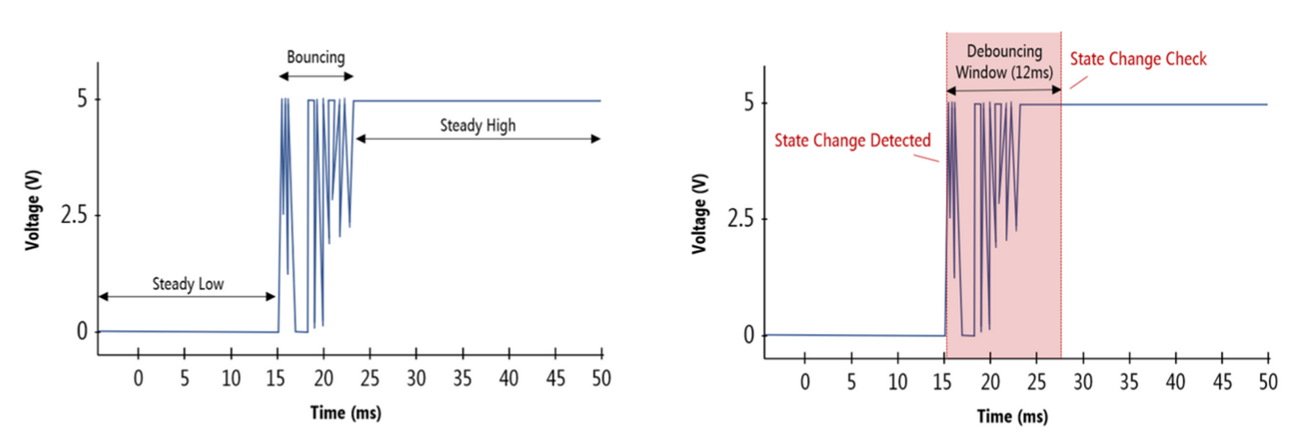
Bouncing and Debouncing
Debounce
Example
Bounce
if (PullUp== LOW) {
delay(50);
// Wait for bouncing time
if (PullUp== LOW) {
Button confirmed
}

Slide 37
Complete Assignment (code)
When temperature is greater than 26 and less than 50 turn on led .
When temperature is greater than 70 and less than 100 turn on buzzer with led .
Else turn off all .

Slide 38
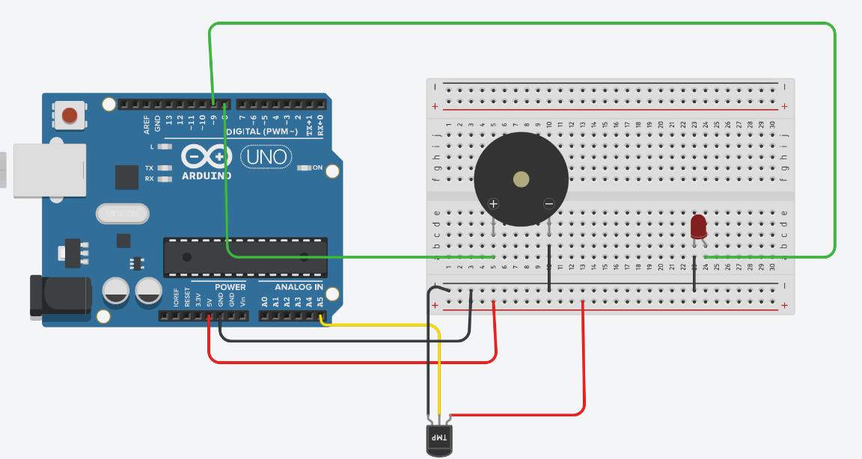
Revise your Connection

Slide 39
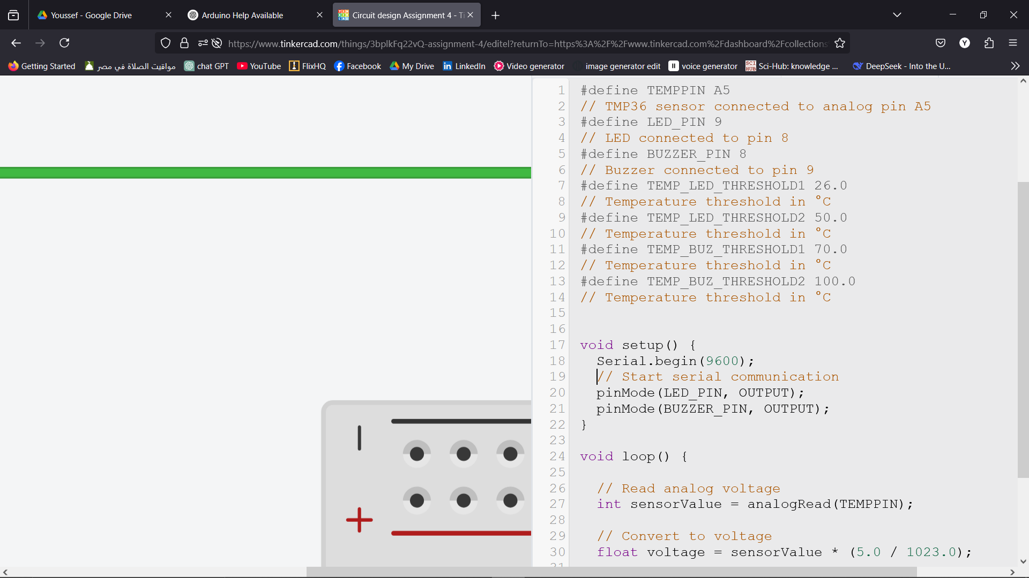
Code

Slide 40
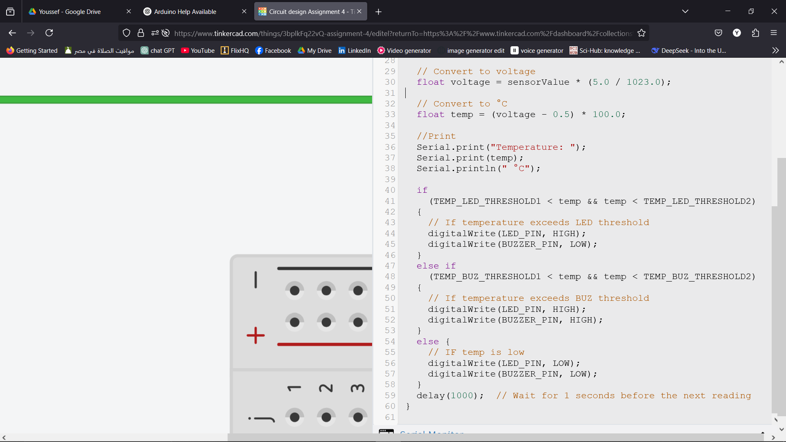
Code

Slide 41
Assignment 5

Slide 42
Assignment 5
Components needed: 2 buttons + 2 LED
When 2 push button are pressed, turn on the led .
When 1 push button is pressed, toggle the led.

Slide 43
Thank You!
Any questions?

